Slide 2


Marwadi University
Rajkot

Slide 3
Index
No. | Description
1. | Uses of certify
2. | Advantages and Disadvantages
3. | Declaration
4. | Acknowledgement
5. | Project Profile
6. | Introduction
7. | Smart contracts
8. | Blockchain Platform
9. | Dapp & Structure
10. | Purposed System

Slide 4
11. | Method Implemented
12. | Technology Used
13. | App Logo
14. | Login Method
15. | Login Site
16. | Verification

Slide 5
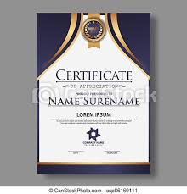
Certify India
This Validating cum E-certificate generation project which we named as CERTIFY INDIA can be the future of certification authentication and generating system we can generate result certificate’s migration certificate university certificates and any course or internship or job certificates
It is secure and reliable because of its blockchain backend and in this phase of digital India one can get their certificates online without any problem from anywhere and we don’t have to carry physical certificates and organizations don’t have to worry about verifying the documents they can instantly validate the certification.

Slide 6
Uses of Certification:
This system of certificate validation can be used world wide from anywhere on internet, organizations can store information’s of the certificate they have issued, or generate the certificate on the web site and the person to whom the certificate is issued can access the certificate from anywhere after validating themselves with blockchain wallets this system of validating and generating certificates can bring a revolutionary change in the private and government sector many process like hiring and admission process can be done in a much easier way .

Slide 7
Declaration
We are the students of MCA, MSc Cybersecurity, Data Science & BSc IT semester 3, hereby declare that the project work presented in this Azadi Ka Amrit Mahotsav is our contribution and have been carried out under supervision of our mentor of FoCA Department of Marwadi University, Rajkot.
The main objective of this training undertaken is to get specialized knowledge in a particular specialized field, which further sharpen the skill and also include that it is a part of our studies undergoing.
Place: Rajkot
Date: 07-10-2021
Thank you

Slide 8
Acknowledgement
I am the student of BSc(IT) studying in the Marwadi University Rajkot. Thanks the entire person who has landed their support in shaping of the systemic
I Mr. Ravirajsinh Vaghela(M.C.A department) before giving me full guidance and cooperation in understanding the system. I also thank them for their unconditional help in making of this project.
I have great deal of gratitude towards our Head Of Department who encourage us in taking up this activity. I thank all faculties and administrative staff of the institute in enhancing their cooperation.

Slide 9
Project Profile
Developed At | :- | Marwadi University
Developed for | :- | Government Organization
Developed By | :- | Kanishk , Nisarg, Vivek, Vishal, Komal Bhagchandani, , Disha Sanghavi , Simran, Rachit.
Main Pages | :- | Home page (activity_home.xml)
Operating System | :- | Microsoft Windows 10
Web Server | :- | Local server
Language | :- | solidity, NodeJS
Editor | :- | Laravel , ReactJS
Platform | :- | web page
Guided By :- |  | Mr. Raviraj singh Vaghela
Submission At :- RK University,Rajkot

Slide 10
INTRODUCTION

Slide 11
OVERVIEW
Basically we are creating a secure certificate Management system that generates certificates
Store it in a Blockchain network by which the user can access his/her certification and Show it a
valid document to any organization or person and the organization can validate the certificate
in seconds
We are using Ethereum based D-app for generation of certificates and converting into a hash
And Meta mask Browser Extension As a crypto wallet for creation and accessing certificates on IPFS

Slide 12
Background and Motivation

Slide 13
Objective
Creating a decentralized blockchain application
It is traceable tamper proof and encrypted
Tackle the problem of fake certificates
We will use smart contract backend to interact with the blockchain and the encrypted hash value of each document will be stored in blockchain which will be verified against the user document
The ordinary document verification is a very slow process, takes a lot of steps, involves a lot of a man work
Tampered or forged documents which looks too real and cannot be traced
The recover of the document won’t be aware of the document history and cannot trace the way backn

Slide 14
Technology Used
Front-end server
HTML
CSS
Bootstrap
Metamask Browser Extension
Solidity
Back-end server
Solidity for Ethereum
EVM Virtual Machine
Security IPFS

Slide 15
Methods implemented
CUSTOMER USER:
This application consists of following modules:
Register – To registration we need to fill this information.
Details: Username and password.
Login - The First step is to login in the app with the help of the credentials.
Details: username or Email id and password.
Home page – The login activity.
User profile page – Given the detail about document.
User profile Detail – The user detail need to input.

Slide 16
Functional Specifications

Slide 17
Tools Description

Slide 18
PROOF OF CONCEPT

Slide 19
What are Smart Contracts
It is capable of facilitating, executing, and enforcing the negotiation or performance of an agreement(i.e. contract) using Blockchain technology
It is verified & signed
Like a Microservice
Enrolled in Language called Solidity

Slide 20
Which blockchain platform would be used ?
Ethereum
Ethereum is an open software platform based on blockchain technology that enables developers to build and display decentralized applications.
Ethereum blockchain allows us to execute code with the Ethereum Virtual Machine(EVM) on the blockchain with the something called a smart contract

Slide 21
Dapp & Structure
Decentralized application-
It is decentralized in every way
The network, the data and the even the
code
Runs on a distributed computing
system

Slide 22
Purposed System contd.
Develop an Ethereum Blockchain to store transactions about the digital certificates
Shared distributed transaction ledger allows proof of existence of digital certificate
The user can access and store documents on IPSF storage
Website for best user experience

Slide 23

App Logo:

Slide 24
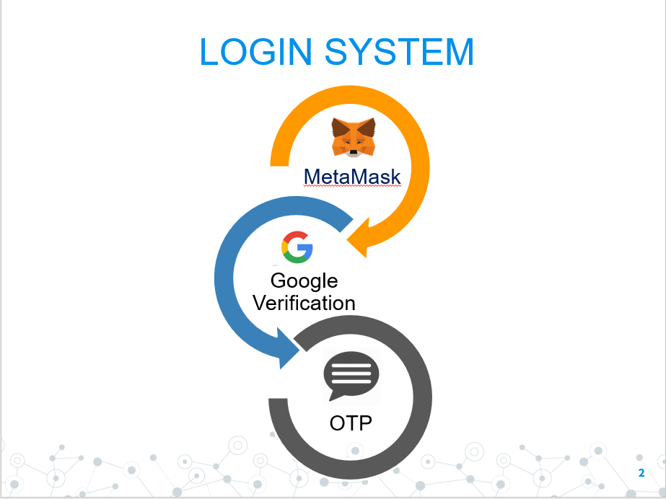
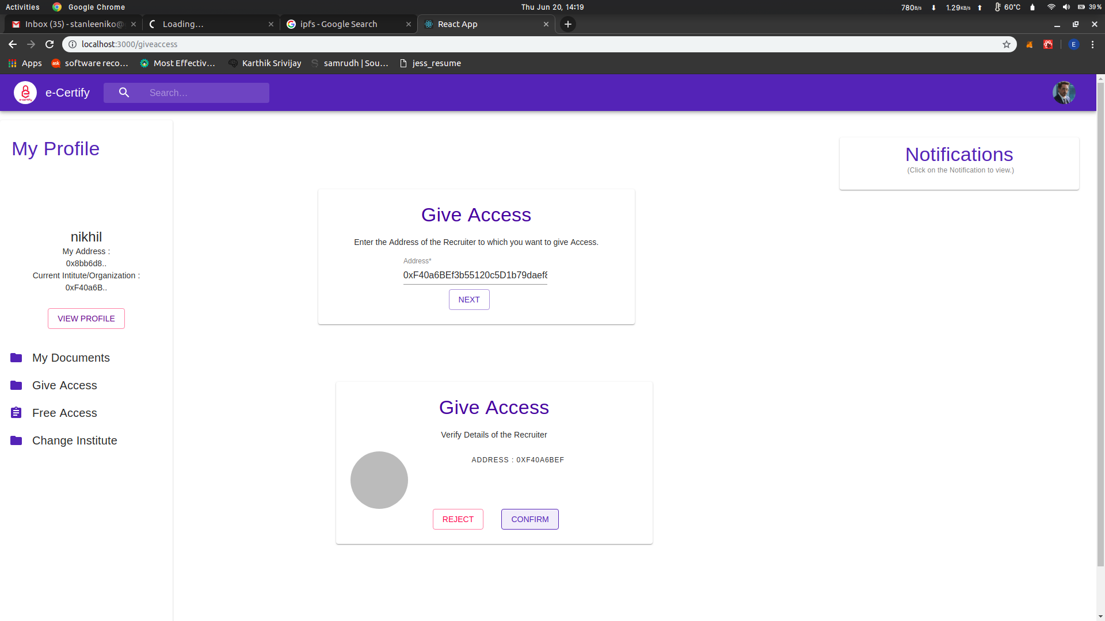
Login Method

Slide 25
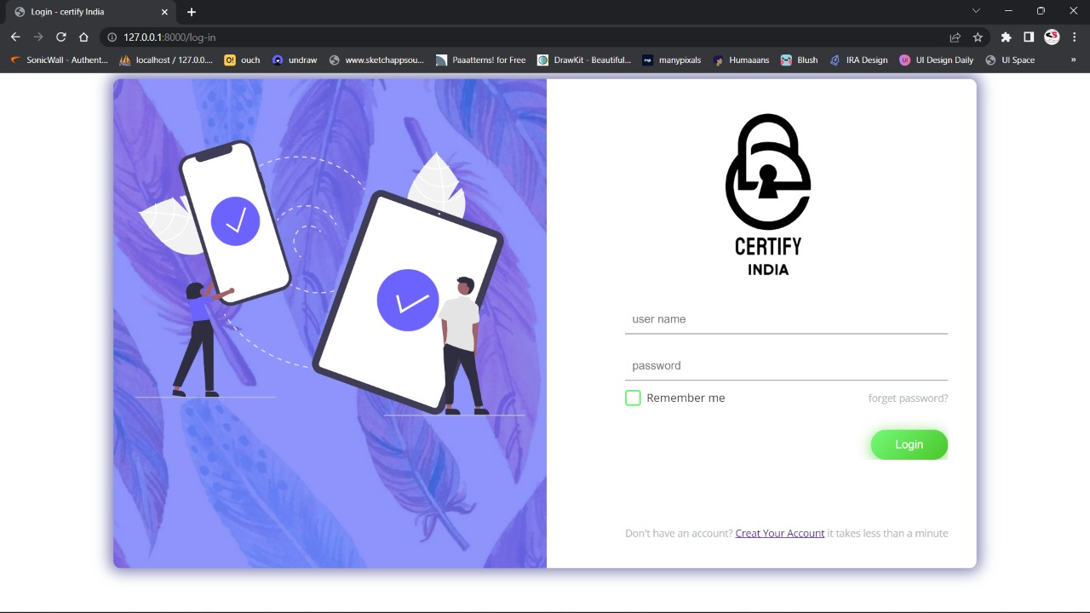
LoginSide

Slide 26
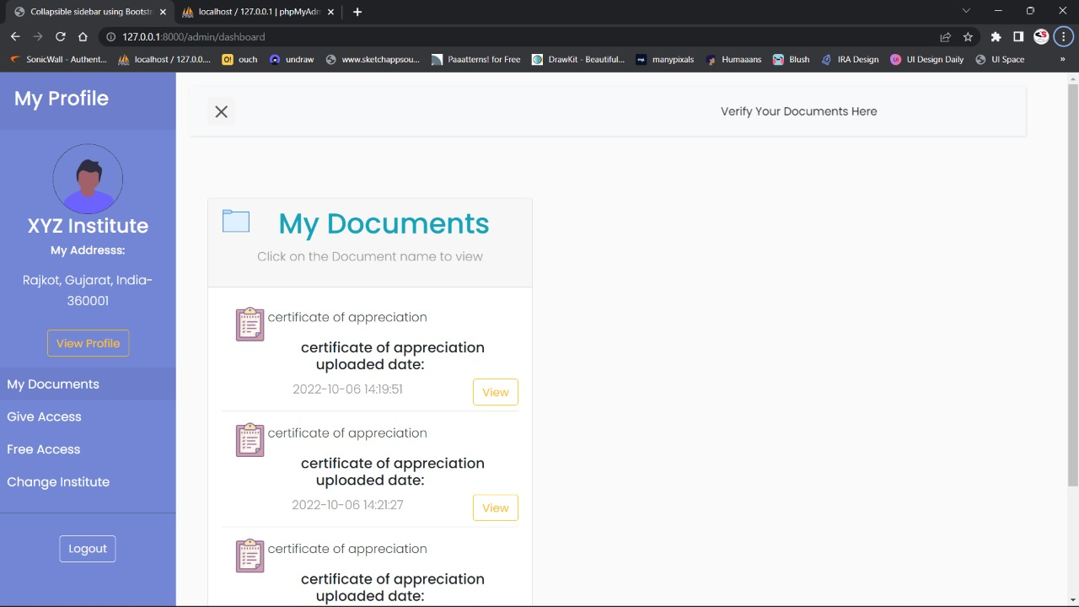
Home page:

Slide 27
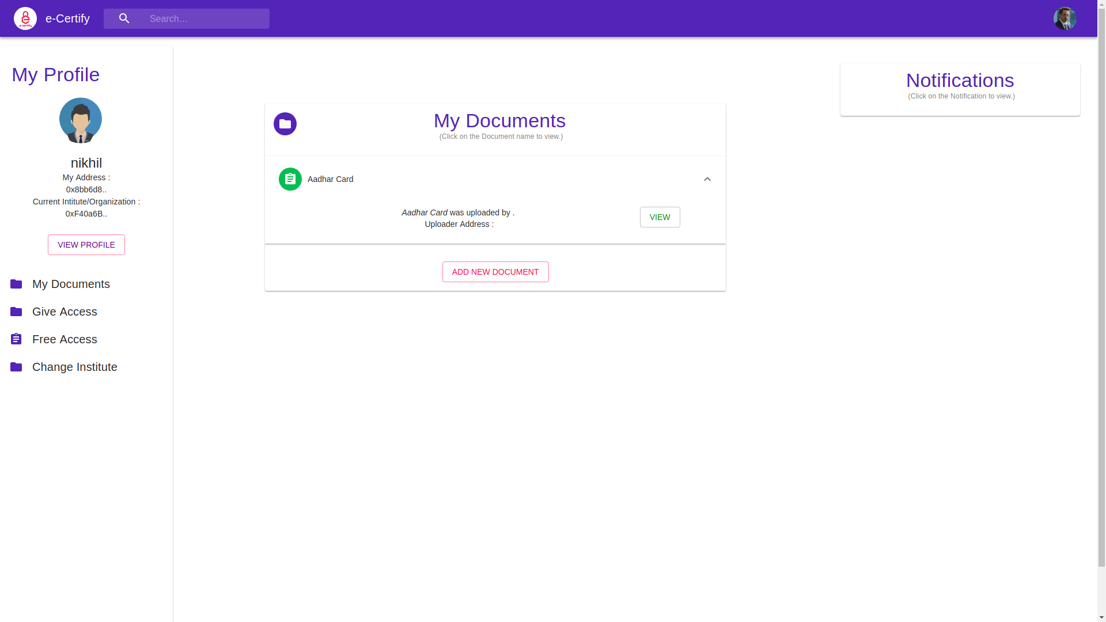
Verify Documentation

Slide 28
Thank You

